Slide 1

Drupal
The Good, the Bad and the Ugly
Dave Elsmore
01/06/2016

Slide 2

What is Drupal?
Open Source Content Management System
Webserver: Apache, Nginx or IIS
Database: MySQL, PostgreSQL or SQLite
Written in PHP

Slide 3
Who’s using Drupal
The White House https://www.whitehouse.gov
Data.gov.uk https://data.gov.uk/
World Bank http://www.worldbank.org/
Le Figaro http://www.lefigaro.fr/
Universal Music http://www.universalmusic.com/
Google Measurement Lab http://www.measurementlab.net/

Slide 4
What is Drupal?
Core install provides basic features
E.g. generic content type, blog, contact form
Functionality extended with additional modules
Modules provided by a large developer community
Currently 18,841 available modules
Also 2,284 themes available

Slide 5
Commerce Modules
1,457 modules
WorldPay Payment Integration
Commerce Shipping
Google AdSense Integration
Payment
SagePay
Commerce Shipping
Currency
Rooms

Slide 6
Geo/Location Modules
449 modules
GMap
GeoField
OpenLayers Geocoder
Geocoder
Leaflet
Smart IP
Location Taxonomize
Mappy
Route Planner

Slide 7
Community Modules
1,107modules
Social Media
Advanced Forum
Twitter Block
Instagram Block
ShareThis
LinkedIn Integration
Chatroom
Twitter Follow Block
Ridiculously Responsive Social Share Buttons

Slide 8
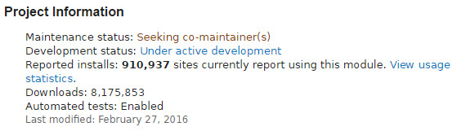
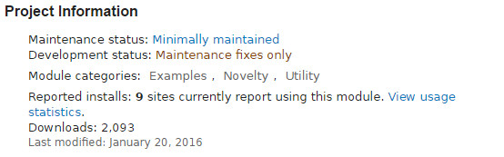
Drupal Modules
Views Module
Beer O’Clock Module

Slide 9
Drupal Distributions
Distributions provide site features and functions for a specific type of site as a single download containing Drupal core, contributed modules, themes, and pre-defined configuration.
1,044 Distributions including
UberCart
Commerce Kickstart
Open Restaurant
Conference Organizing
Recruiter
Open Academy

Slide 10
Drupal Pros
SEO Optimized
Accessibility
Security
Multilingual capabilities
Customizable
Flexible

Slide 11
Drupal Cons
Complexity makes it difficult to learn
Multitude of modules makes it difficult to establish best practice
Complex database schema
SLOW – caching helps but still problematic
Front ends feel ‘clunky’

Slide 12
Traditional Subscriber Table
subscribers
ID | FirstName | LastName | PersonalTitle | Email
1 | Dave | Elsmore | Mr | david.elsmore@ed.ac.uk
2 | Jo | Bloggs | Ms | jo.bloggs@example.com
Select * from subscribers where LastName = ‘Elsmore’
Notes:
Focus here is on geodata service team activities over last year or so.

Slide 13
Drupal Subscriber/Supplier Tables
node
node_type
NID | type | title
1 | subscriber | Dave Elsmore
2 | subscriber | Jo Bloggs
type | description
subscriber | Content type to record subscribers
field_first_name
field_personal_title
entity_type | entity_id | first_name_value
subscriber | 1 | Dave
subscriber | 2 | Jo
entity_type | entity_id | personal_title_value
subscriber | 1 | Mr
subscriber | 2 | Ms
field_last_name
field_email
entity_type | entity_id | last_name_value
subscriber | 1 | Elsmore
subscriber | 2 | Bloggs
entity_type | entity_id | email_value
subscriber | 1 | david.elsmore@ed.ac.uk
subscriber | 2 | jo.bloggs@example.com

Slide 14
Drupal Subscriber Table
SELECT node.ID, field_last_name.last_name_value, field_first_name.first_name_value, field_personal_title.first_personal_title_value, field_email.email_value
FROM (((node INNER JOIN field_last_name ON node.ID = field_last_name.entity_id) INNER JOIN field_first_name ON node.ID = field_first_name.entity_id) INNER JOIN field_email ON node.ID = field_email.entity_id) INNER JOIN field_personal_title ON node.ID = field_personal_title.entity_id where field_last_name.last_name_value = 'Elsmore';

Slide 15
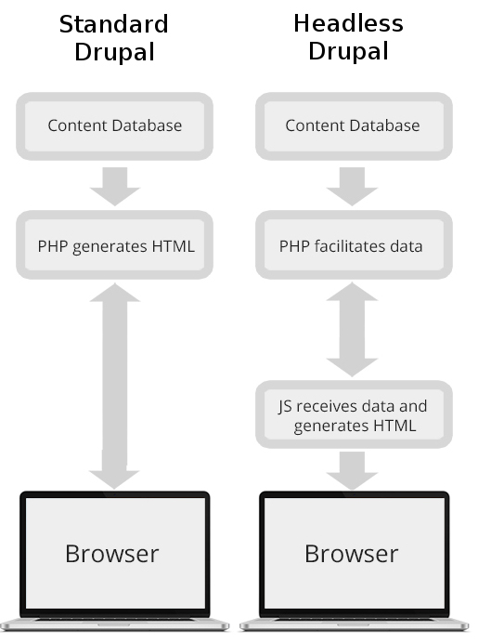
Headless Drupal

Slide 16
Questions?

